Slide 1
Exploratory Drivers of Transition as Applied on Workforce Modelling
Joel Bancolita, Social Wellbeing Agency
Innovations in Applied Data Symposium
3 June 2021, Te Papa
Notes:
Outline:
Background
Basic research questions
Primary: includes updating definition led by MoH and the Kaiawhina Taskforce; after initial consultation with MoH Workforce Directorate we started building on the Action Plan workforce based on the 2013 Kaiawhina Profile report by BERL; aimed at describing the workforce in terms of age, sex, and ethnicity; and their employment profile such as qualifications, industry, region, and income, i.e. update figures in the BERL report
Secondary: depends on how the data and findings in primary question/s will turn out given time
How are these factors related to their household characteristics (e.g. partners and dependents), wellbeing, or job/life satisfaction?
e.g. employed in another occupation, training, education, overseas, benefit
These answers may inform training and funding
Transition analysis framework
Classification problem
Current status and moving forward
Background:
Early 2020, SWA shared initial results of exploratory descriptive and transition analysis on ECE for MoE, and Mental Health Workers with Health Workforce Directorate
Directorate has been doing more advanced work on this registered workforce group—however, MoH indicated an opportunity for collaboration with regards to Kaiāwhina
Partnership between MoH and SWA has begun shaping to extend and enhance SWA work on exploratory analysis of workforce
Bolstered by being a component workforce analysis for the Social Wellbeing Board (SWB) as one sector of the unregistered workforce.
THIS IS A MIX OF DATA WRANGLING, CLASSIFICATION AND MODELLING

Slide 2
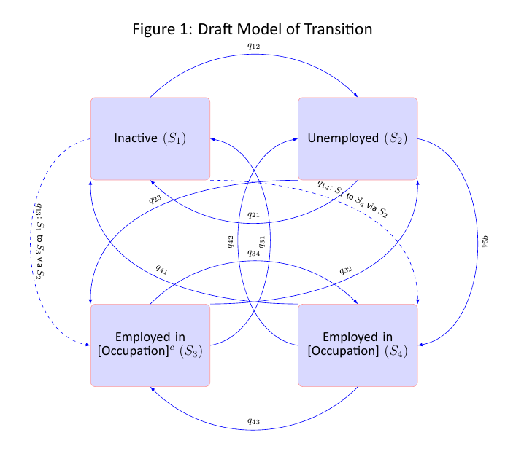
Draft transition analysis framework
Age
Qualification
Income
Sector
Sex
Location
Ethnicity
Aims to analyse transitions according to various characteristics e.g. qualification, age.
Arrows represent transitions between various states for an individual
Notes:
We tried to develop a transition framework, to model people moving in and out of the workforce. This will help us answer questions based on demographic characteristics, such as: How long does a female stay in the workforce compared to males?
Related steps:
Estimate probability of being in an occupation to describe the occupation in terms of their drivers, barriers and characteristics using markov multistate modelling
Attempt to derive transition matrix to describe and visualise propensity of individuals to move from one state to another and what are the factors that affect these movements

Slide 3
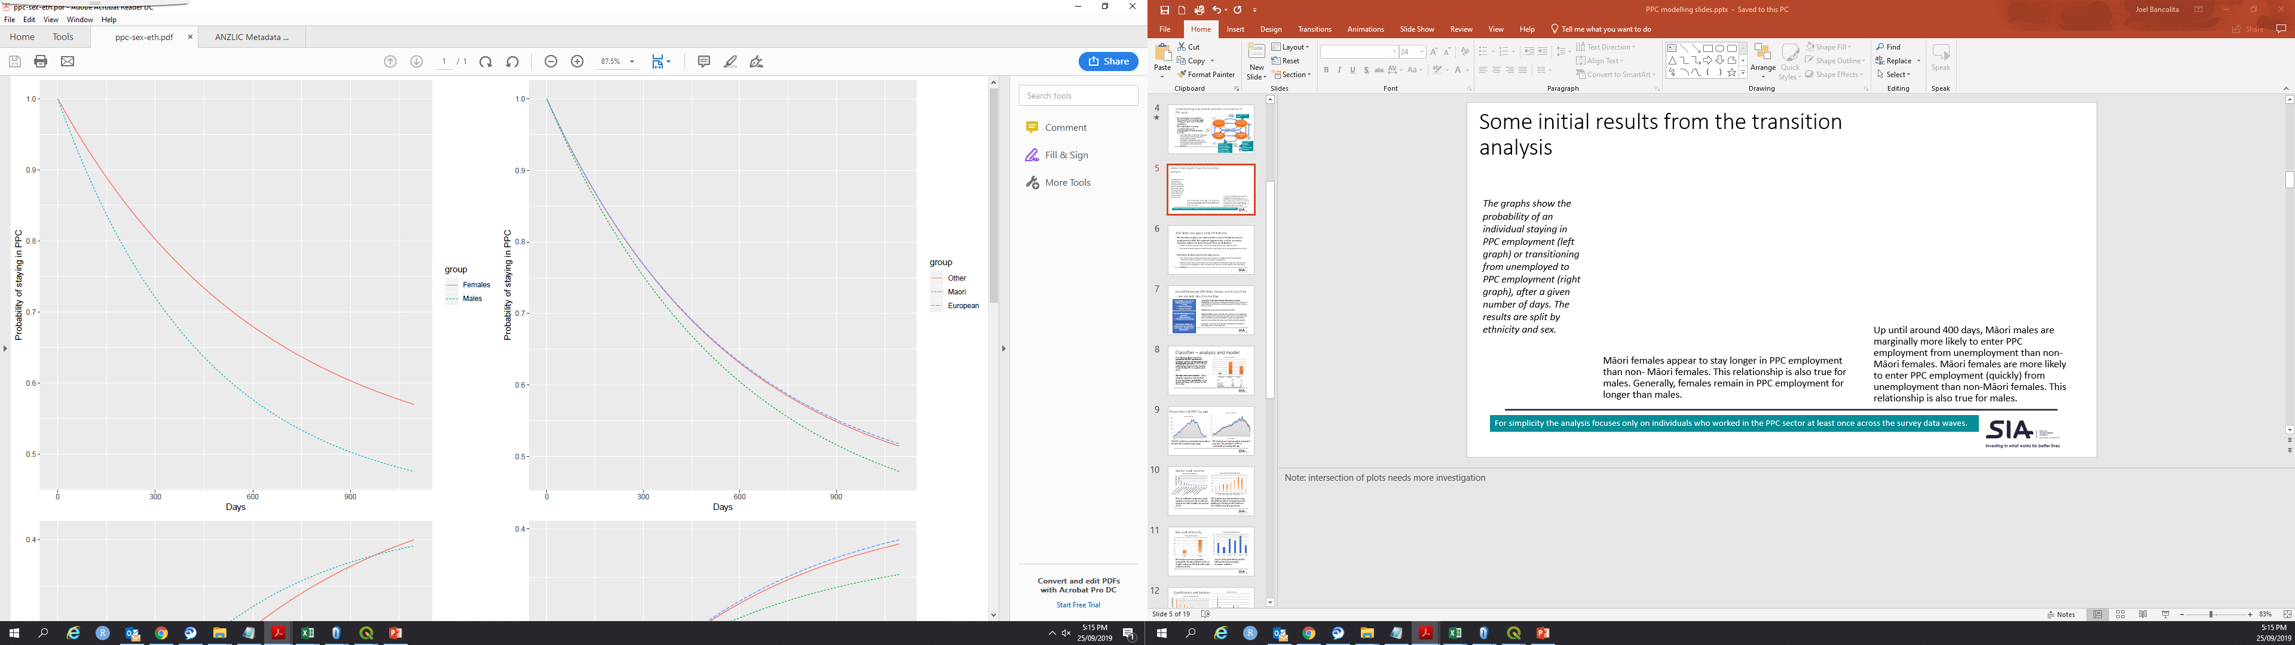
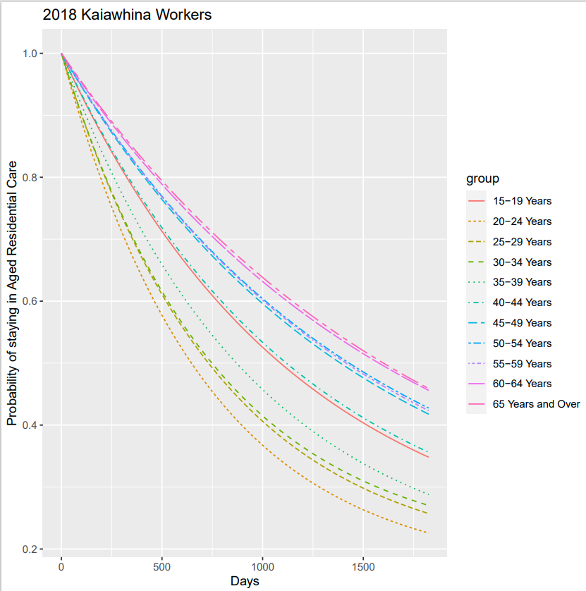
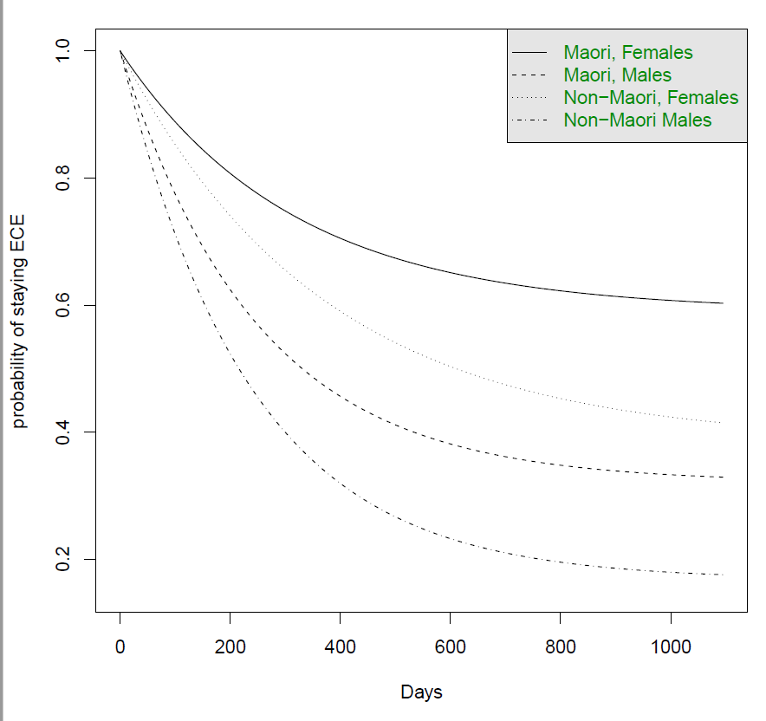
Some initial use cases results IR (left), SoFIE (right)
IDI Disclaimer
These results are not official statistics. They have been created for research purposes from the [Integrated Data Infrastructure (IDI) and/or Longitudinal Business Database (LBD)] which [is/are] carefully managed by Stats NZ. For more information about the [IDI and/or LBD] please visit https://www.stats.govt.nz/integrated-data/.
Access to the data used in this study was provided by Stats NZ under conditions designed to give effect to the security and confidentiality provisions of the Statistics Act 1975. The results presented in this study are the work of the author, not Stats NZ or individual data suppliers.
The results are based in part on tax data supplied by Inland Revenue to Stats NZ under the Tax Administration Act 1994 for statistical purposes. Any discussion of data limitations or weaknesses is in the context of using the IDI for statistical purposes, and is not related to the data’s ability to support Inland Revenue’s core operational requirements.
Notes:
Note: intersection of plots needs more investigation
The graphs show the probability of an individual staying in Aged Residential Care by age (left), in mental health employment by sex (upper right), in ECE by ethnicity/sex (lower right)
Left: Females stay longer in mental health employment than males.
Right: Māori females appear to stay longer in ECE employment than non- Māori females. This relationship is also true for males. Generally, females remain in ECE employment for longer than males.

Slide 4
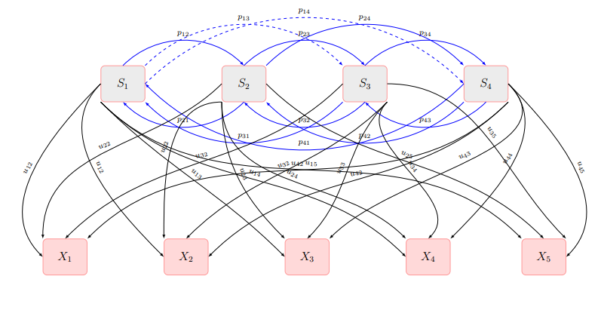
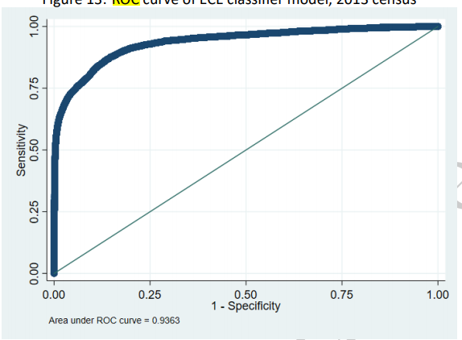
Current Status
Ongoing prediction problem: missing values (i.e. occupation) over time
Approaches: Linking data, Probabilistic, Machine learning
Tapping into Informatics partners expertise in predictive modelling
Challenges
Computational challenges (environment), Replicability, Usability
Use case: Kaiawhina collaboration with Ministry of Health (MoH) Workforce Directorate
They utilise our IDI expertise to replicate their workforce forecasting onto Kaiawhina
We in turn use their subject matter expertise in understanding the workforce
Acknowledgements
Craig Wright, Marianna Pekar, Karan Singh, Freya Li
Notes:
Problem: structured approach to classification, e.g. IR<-> census
We also have included variables relevant to analyses such as health urbanity or accessibility—from Health Workforce Directorate.
We are also working with modelling experts to improve the way we analyse transitions and how it is relevant to workforce.
Lacking subject matter expertise, we sought guidance from MoH and KWAP/Network in defining and refining the Kaiāwhina workforce. As a starting point, we’ve begun building on previous BERL report, where ANZSCO was utilised as tool to identify occupation, particularly in census which is also the case in IDI. This is acknowledged as a current gap and one of the tasks that’s needed to be pinned down for a more meaningful analysis.
As a collaboration, we include MoH Workforce Directorate researchers in the IDI project.

